Slide 1

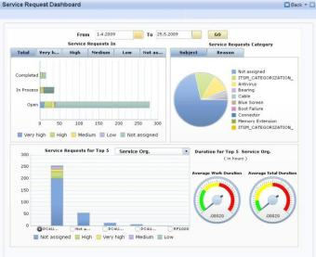
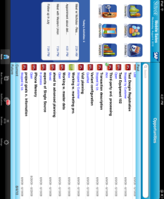
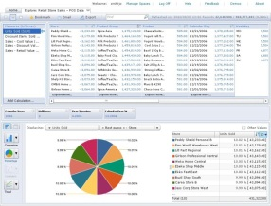

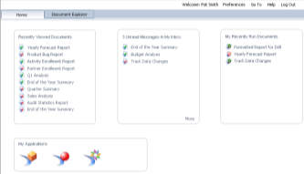
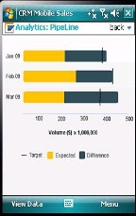
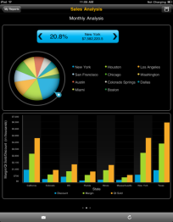

SAP HANA in Healthcare: Real-Time Big Data Analysis
David P. Delaney, MD
Chief Medical Officer
SAP America

Slide 2

Agenda
Our POV on Healthcare and Big Data
SAP HANA Innovations
SAP HANA Transformational Impact at Customers
Summary

Slide 3
Agenda
Our POV on Healthcare and Big Data
SAP HANA Innovations
SAP HANA Transformational Impact at Customers
Summary

Slide 4
U.S. healthcare spending
$5.5
5
4.5
4
3.5
3
2.5
2
1.5
1
0.5
0
$4.78
2021 projected
2021
19.9%
Projected
1960
2010
2020
Notes:
¾ of spending on chronic illness – in fact sickest 5% responsible for over half spend.
About 20% of spending on chronic illness or 560B is preventable
* % Federal spending up from a little over 10% of budget in 1980 to estimated 30% of budget in 2016

Slide 5
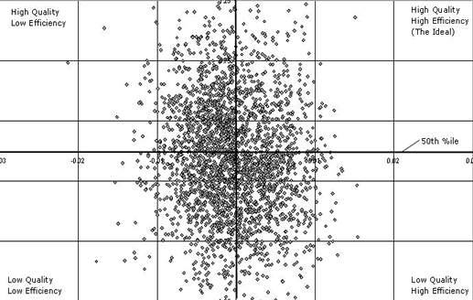
Bend the cost curve: Era of value-based care
Distribution of Physicians by Quality and Efficiency
50th %ile
Evidence-based Medicine
Value-based Medicine

Slide 6
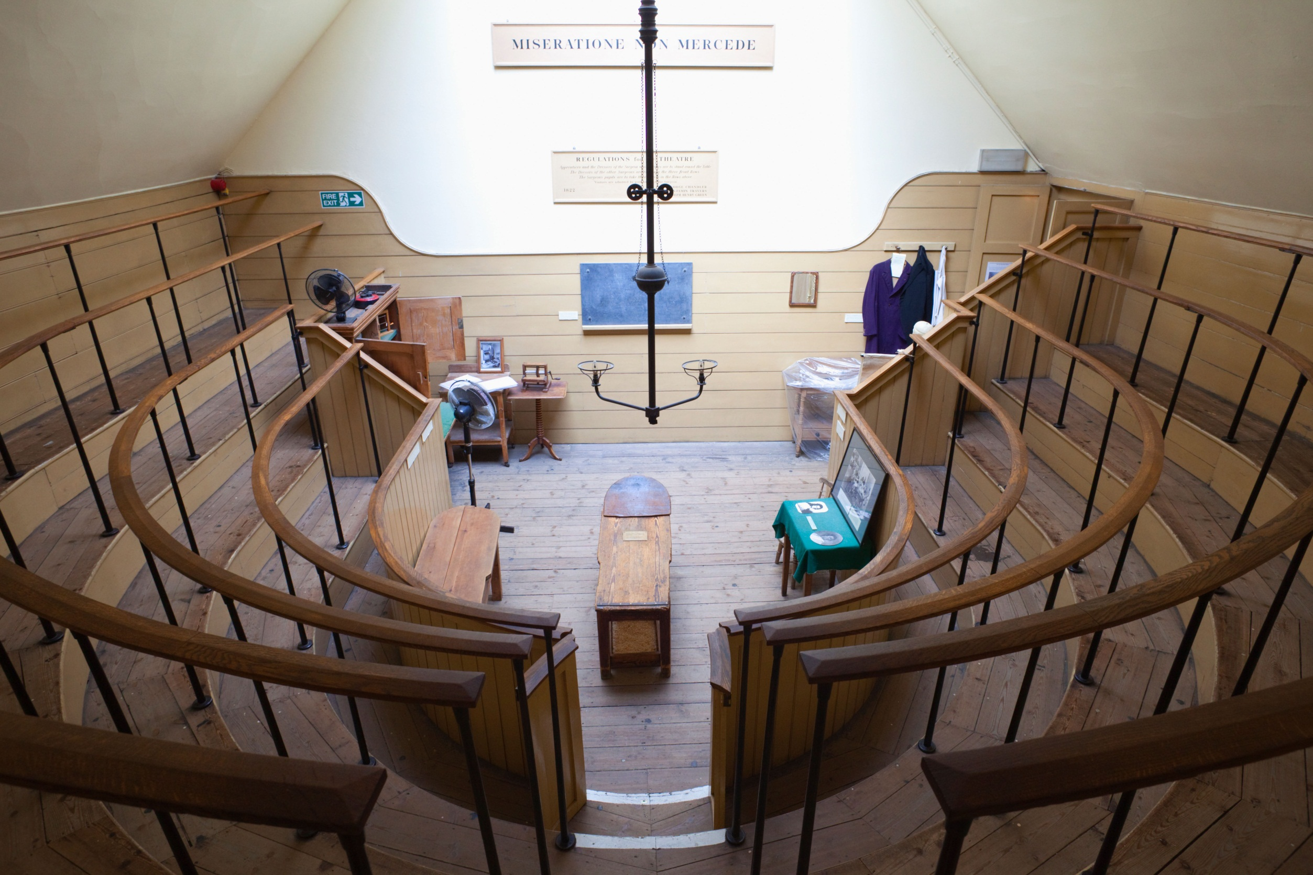

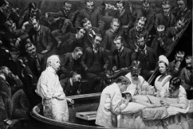

Healthcare delivery: the last, greatest cottage industry
Notes:
-1846 - ether

Slide 7

Drowning in data…
Challenge: Discovery and Distribution
Notes:
2.5 quintillion (2.5×10¹⁸) bytes of data per day,
World’s actual volume of data grows much more rapidly, doubling every 18 months according to the IDC.
Rate at which we are creating data vastly outstrips our ability to effectively create value from it.
Need to turn data into information to lead to insight and create impact

Slide 8
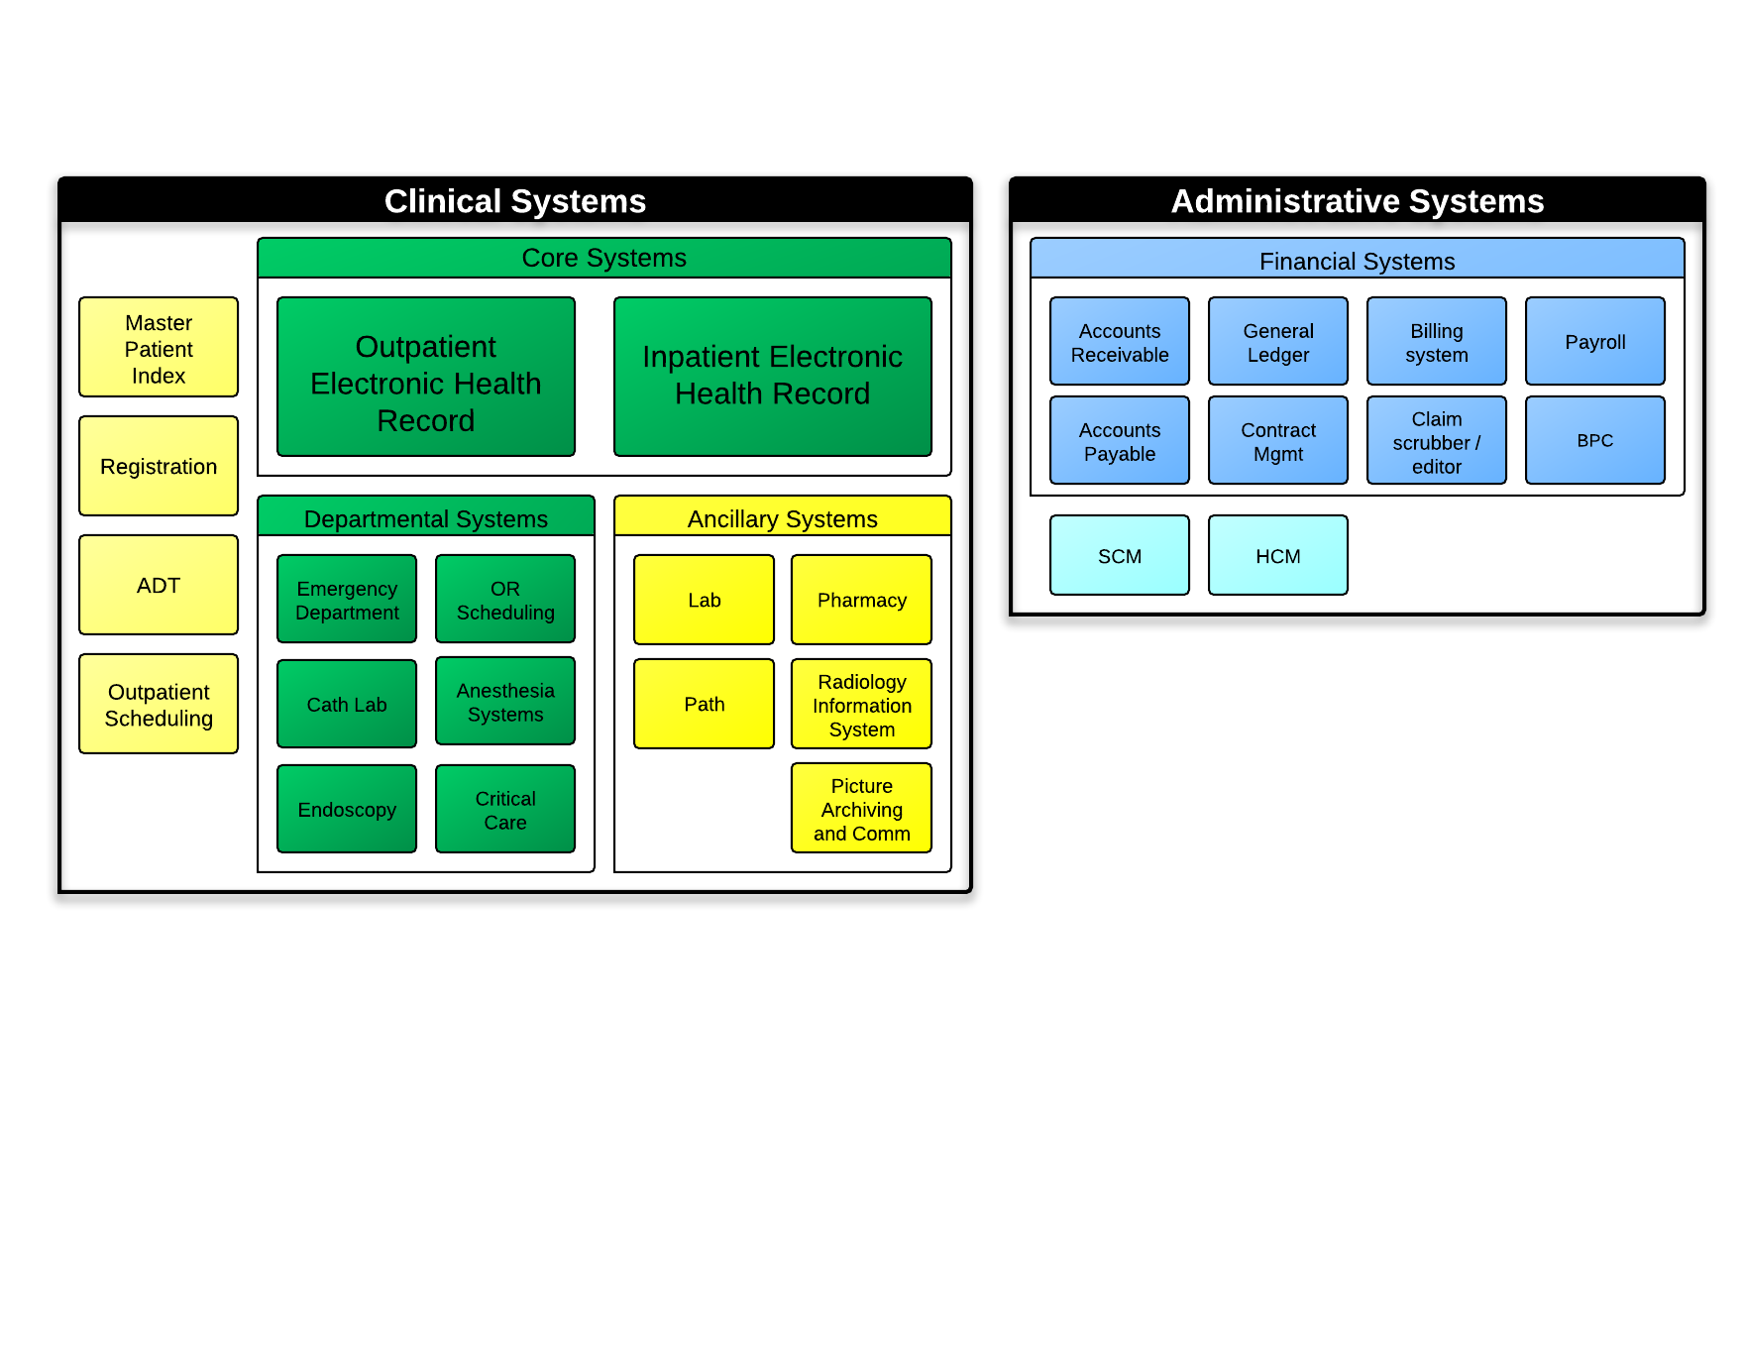






Fragmented data
Business Intelligence
Reports, Dashboards
Data Integration
Acute care

Slide 9
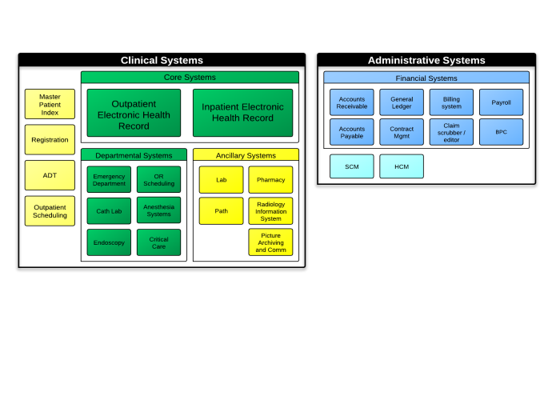








ACOs: Great concept, execution often elusive
Business Intelligence
Reports, Dashboards
Data Integration
Business Intelligence
Reports, Dashboards
Business Intelligence
Reports, Dashboards
Business Intelligence
Reports, Dashboards
EDW
EDW
EDW
Data Integration
Data Integration
Data Integration
Pre-acute care
Acute care
Post-acute care

Slide 10
Agenda
Our POV on Healthcare and Big Data
SAP HANA Innovations
SAP HANA Transformational Impact at Customers
Summary

Slide 11









Modern hardware and software architecture Provided opportunities to re-design DBMS to reduce latency
Multi-Core Architecture 8 CPU x 10 Cores per blade
Massive parallel scaling with many blades
64bit address space 1 TB in current servers
Dramatic decline in price/performance
CPU
L3
Cache
L3
Cache
L3
Cache
L3
Cache
L3
Cache
L3
Cache
L3
Cache
L3
Cache
MEMORY
OLTP+OLAP in column Store
Partitioning
Inset Only on Delta
No Aggregate tables (Dynamic Aggregation)
Compression
Logging and Backup
STORAGE
Solid State
Flash
HDD

Slide 12
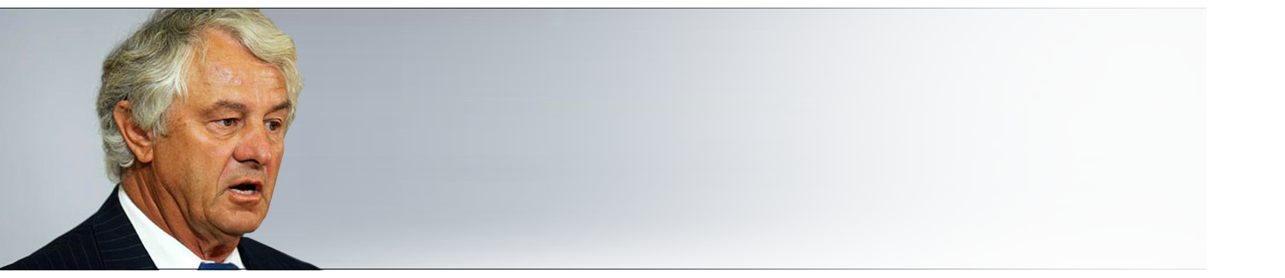








Re-think data management for real-time business Need to eliminate redundant data copies, materialization and models
A Common Database Approach for OLTP and OLAP Using an In-Memory Columnar Database
Hasso Plattner
Separated Transactions + Analysis + Acceleration Processes
One Atomic Copy of Data for Transactions + Analysis, All in Memory
ETL
SAP HANA (DRAM)
ETL
Cache
VS
Transact
Analyze
Accelerate
3 copies of data in different data models
Inherent data latency
Poor innovation leading to wastage
Eliminate unnecessary complexity and latency
Less hardware to manage
Accelerate through innovation and simplification
Notes:
3 copies of data
In different data models
Inherent data latency
Accelerate through cache
In recent years, computer systems have increased number of processing cores with large integrated caches.
Main memory space has become practically unlimited with the ability to hold all the business data of enterprises of every size. Falling prices have moved processing from Disk/SSD to In-Memory.
Memory access is 1M – 10M times faster than disk.
Disk-centric computing was also one of the major factors that forced separation of transactional and analytical workloads. Moving data to various locations was necessary for reporting to circumvent network issues. Pre-processing of data then became the necessity to optimize linear data transfers. We do not have to live with those limitations any more. Feasibility is given.
Through advances in data sciences combined with relevant hardware trends, SAP is leading the real-time computing revolution… leveraging the power of in-memory computing to bringing OLAP and OLTP back together in one database.
This transforms how we construct business applications and our expectations in consuming them. Adopting this new technology will sharpen your competitive edge by dramatically accelerating not only data querying speed but also business processing speed.

Slide 13






SAP HANA: Renovate existing systems while enabling future breakthroughs
SAP BusinessSuite & SAP BusinessOne
StartUp & ISV Apps
30+ SAP HANA Apps, Accelerators & RDS
Operational Datamarts
Industry Platforms (Healthcare)
SAP NetWeaver BW powered by SAP HANA
REAL-TIME APPLICATIONS
REAL-TIME ANALYTICS
Consumer Engagement
Sense & Respond
Planning & Optimization
Operational Analytics
Big Data Warehousing
Predictive, Spatial & Text Analytics
Real-time Platform
Database & Data Processing Services
Application Platform Services
Integration & Data Virtualization Services
Mission-Critical Deployment Services (Appliance, Cloud)
Notes:
SAP HANA brings together the power of In-memory, HADOOP, Predictive, Text Mining and Spatial Analytics, and a full suite of powerful modeling technologies, to extract value from Big Data
Build an entirely new set of applications
Redefine business models
Assist companies enter new industries
SAP HANA® is the only platform that can renovate existing systems while enabling innovation to meet future business needs non-disruptively. The goal of SAP HANA is to simplify your business and technology landscape, while allowing you to execute faster and react smarter. SAP HANA offers increased efficiency via automated business processes, one source of the truth with easy integration of all data, including consumer-grade usability accessible on any device.

Slide 14
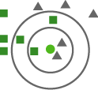
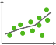



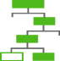
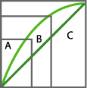








Predictive analytics & machine learning Transforming the future with insight today
Hadoop/Sybase IQ, Sybase ASE, Teradata
SAP HANA
KNN classification
Regression
Main Memory
K-means
C4.5 decision tree
Virtual Tables
SQL Script Optimized Query Plan
ABC classification
Associate analysis: market basket
Weighted score tables
Spatial, Machine, Real-time Data
Text Analysis
PAL
R-scripts
R-Engine
Spatial Data
Unstructured
HANA Studio/AFM, Apps & Tools
Accelerate predictive analysis and scoring with in-database algorithms delivered out-of-the-box. Adapt the models frequently
Execute R commands as part of overall query plan by transferring intermediate DB tables directly to R as vector-oriented data structures
Predictive analytics across multiple data types and sources. (e.g.: Unstructured Text, Geospatial, Hadoop)

Slide 15
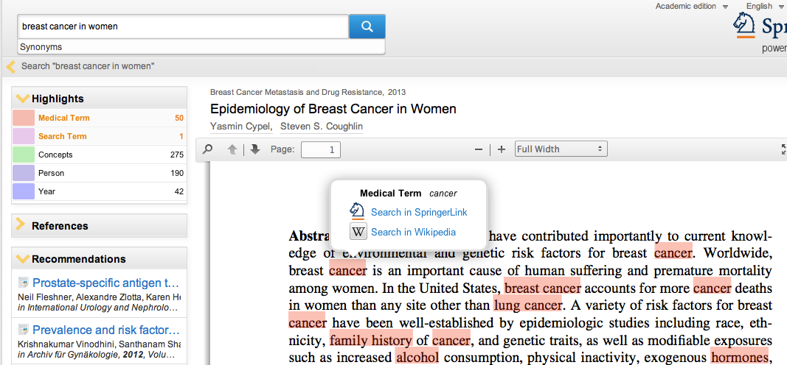







SAP HANA Text Analysis Extract information from documents; perform text analysis on unstructured data
File Filtering
Unlock text from binary documents
Ability to extract and process unstructured text data from various file formats (txt, html, xml, pdf, doc, ppt, xls, rtf, msg)
Load binary, flat, and other documents directly into HANA for native text search and analysis
Native Text Analysis
Give structure to unstructured textual content
Expose linguistic markup for text mining uses
Classify entities (people, companies, things, etc.)
Identify domain facts (sentiments, topics, requests, etc.)
Supports up to 31 languages for linguistic mark-up and extraction dictionary and 11 languages for predefined core extractions
SAP HANA Text Analysis
Notes:
File Filtering
Unlock text from binary documents
Ability to extract and process unstructured text data from various file formats (txt, html, xml, pdf, doc, ppt, xls, rtf, msg)
Load binary, flat, and other documents directly into HANA for native text search and analysis
Native Text Analysis
Give structure to unstructured textual content
Expose linguistic markup for text mining uses
Classify entities (people, companies, things, etc.)
Identify domain facts (sentiments, topics, requests, etc.)
Supports up to 31 languages for linguistic mark-up and extraction dictionary and 11 languages for predefined core extractions

Slide 16

Deployment services Provides security, privacy, and availability
Choose and change your deployment options anytime
3rd Party Apps
Bus. Suite
BA
BW
Ariba
SuccessFactors
On Premise
Hybrid
Cloud
Run All SAP Solutions on SAP HANA
Build or deploy your own solutions on SAP HANA
Maintain all within your firewall
Upgrade or leverage existing infrastructure
Leverage SAP Cloud
Migrate some solutions to the cloud
Create or deploy new SaaS apps in the cloud
Use cloud hosting and managed services
Deploy via SAP HANA Enterprise Cloud or public cloud
Build, Run, Deploy all Applications in the Cloud
Consider Virtual Private Cloud option
Enable faster innovations
Simplify landscape
Migrate or build new applications in SAP HANA Enterprise Cloud

Slide 17

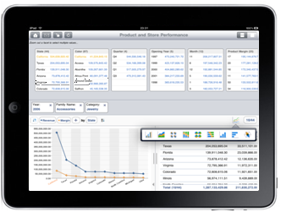

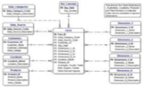
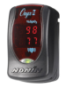
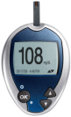
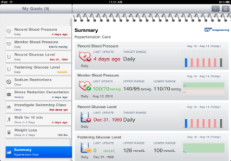
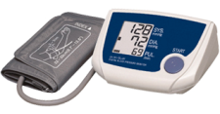
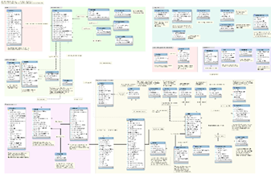
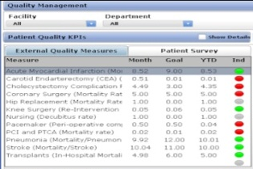

SAP HANA Platform Extending SAP HANA Platform to power the next generation of healthcare
Any Apps
on Any App Server
Any SAP Applications
on SAP App Server
Native HANA Applications
on SAP HANA App Server
SQL
MDX
R
JSON
Open Connectivity
EHR
SAP HANA Health Platform
Extended
App Services
(Web Server)
Java Script
OData
Procedural App Logic
DB-oriented Logic
R Integration
Predictive
Unstructured
Text Mining
Decision Tables
SQL Scripts
Notes:
Easily migrate your applications (e.g.: Java, PHP, .NET) in almost any language, PHP, Ruby, Java, C, ... the list goes on:
Support for ANSI SQL, ODBC, JDBC, Odata/JSON, and certified 3rd party tools
Support more standards: JSON and XMLA over HTTP so it is a truly multi-dimensional platform
Build new web applications with any open source HTML5 / JS libraries, server-side Java script.
Support advanced text analytics: Analyze text in all columns of table and text inside binary files with advanced text analytic capabilities such as: automatically detecting 31 languages; fuzzy, linguistic, synonymous search, using SQL.
Analyze streaming data from integrated ESP in combination with data in SAP HANA.
Process geospatial data
Accelerate predictive analysis and scoring with in-database algorithms delivered out-of-the-box. Adapt the models frequently.
Execute R commands as part of overall query plan by transferring intermediate DB tables directly to R as vector-oriented data structures.
Predictive analytics across multiple data types and sources (e.g.: Unstructured Text, Geospatial, Hadoop)

Slide 18
Agenda
Our POV on Healthcare and Big Data
SAP HANA Innovations
SAP HANA Transformational Impact at Customers
Summary

Slide 19


Explosion of biological health information
Has surpassed human cognitive capacity
1000
Proteomics and other effector molecules
100
BIG DATA
Facts per Decision
Functional Genetics
10
Structural Genetics
5
Decisions by Clinical Phenotype
1990
2000
2010
2020
The Strategic Application of Information Technology in Health Care Organizations (Third Edition 2011) by John P. Glaser and Claudia Salzberg
20-40% annual increase in medical image archives
1GB – 3D CT Scan
150MB – 3D MRI
30MB – X-ray
120MB – Mammograms
800 MB
Per Genome
300 TB+
200 Cancer Genomes
200 TB+
All Known Variants
15 PB+
Broad & Sanger DB

Slide 20

Genomics Pipeline: Dramatically Accelerated by SAP HANA
Genomics Pipeline
Computationally Intensive
Sequencing
Alignment
Variant Calling
Annotation & Analysis
Patient Samples
Raw DNA Reads
Mapped Genome
Discovered Variants
Follow-up & Validation
Up to 600X Faster
Promising Early Results
Real Genome Data 70x Coverage of Human Genome
Report SNPs (Single Nucleotide Polymorphisms) Falling Quality Control
17X
faster
82X
faster
84hrs Industry Standard (BWA-SW) vs. 5hrs SAP HANA
102.47sec UCSC vs. 1.25sec SAP HANA
Compute the Number of Missing Genotypes for Each Individual
Compute the Alternative Allele Frequency for Each Variant in a Genomic Region (Chromosome 1, Positions 100,000 – 200,000)
270X
faster
600X
faster
548secs VCF Tools vs. 2 sec SAP HANA
259sec VCF Tools vs. 0.43sec SAP HANA
Notes:
POV:
Here is the typical end-to-end tool chain – from raw sequenced DNA to interpreted variants
DNA sequencing pipeline requires interdisciplinary cooperation between biological, medical, and IT experts -> We – as IT experts – investigated alignment and annotation and analysis and verified our results with files from the 1,000 genome project
Speaker notes:
A depiction of the end-to-end "bioinformatic chain" or "DNA analysis pipeline" or "the lifespan of a diagnosis" or some such articulation to capture the sequence of steps that happen today, and their latency. We should depict not only the steps, but also the people/institutions that inhabit/cohabit this pipeline.
Transition:
We tackled “alignment” as well as “annotation and analysis”. First results are presented and here are our results to date.

Slide 21


Mitsui Knowledge Industry Healthcare Industry – Cancer cell genomic analysis
Reduce the time to detect variant DNA
Support personalized patient therapeutics
DNA results 216x faster – in 20 minutes or less
Streamline process of providing individualized cancer drug recommendation
Notes:
Implementation
Batched based big data pre-processing to identify data of interests
Leverage R integration to HANA & PAL for data mining and to uncover patterns
HANA provides in-memory predictive acceleration & correlated analysis
---------------
Product: Real-time Big data (R+Hadoop+HANA)
Business Challenges
Longer wait time (days) for patient results for hospitals that conduct cancer detection from base on DNA sequence matching
Delay in new drug discovery and higher associated costs due to lack of insights in patient data
Technical Challenge
Big data → Lack of speed, accuracy and visibility into data analysis results in huge costs and longer turnaround time for drug discovery and the identification of disease factors
Benefits
For hospitals: Real-time DNA sequence data analysis makes it faster and easier to identify the root cause.
Patient care based on genome analysis results can actually happen in one doctor visit Vs. waiting for several days or multiple follow-up visits
For Pharmaceutical companies: provide required drugs in time and help identify “driver mutation” for new drug target
Competition
408,000 faster than traditional disk-based system
MKI and SAP HANA could alter the course of cancer research in human history
It currently takes 2-3 days for a person to find differences in genome data between cancer patients and healthy people. MKI anticipates the time reduction with HANA to be 20 minutes → 216x faster
HANA is about 408,000 times faster than traditional disk-based system (60 million recs) while performing independent data analysis
HANA is about 5-10 times faster than another competitor. (190milion recs)
R+ Hadoop + SAP HANA → HANA provides us powerful real-time computation capability, and R offers us easy ways to model and analyze the data. Hadoop is the platform with distributed pre-data processing and storage capabilities. Combining all three, we can store, pre-process, compute, and analyze huge amount of data
----------------------------------
One stop service including genomic data analysis of cancer patient to support personalized therapeutics for the patient.
This is not about poor decision making – the healthcare providers are making the best recommendation possible without HANA.
This is about streamlining the process of providing drug recommendation for cancer patient based on a completely changed process, which is only possible through HANA.
2-3 days to analyze data -> 20 minutes to analyze data -> making it possible for the first time that patient care based on genome analysis results can actually happen in one doctor visit vs waiting for several days or multiple follow-up visits.
Genomic DNA analysis in real-time will transform how we enable comprehensive patient care to fight against cancer. SAP HANA will be the mission-critical and reliable data platform to make real-time cancer analytics into a reality
On one hand, Hospital will collect the genome data from patients and the system will analyze the mutation information. On the other hand, Pharmaceutical will provide the specific drugs based on patient’s mutation profile. Or it will help the Pharma researchers and Oncologist to identify “driver mutation” for new drug target.

Slide 22


Charité Berlin Healthcare Industry – Personalized healthcare for cancer patients
Improve cancer treatment with new patient therapies
1,000x faster tumor data analysis (in seconds)
Real-time analysis of 300M patient entries across departments and geographies
Reduced time in staff shift changes
Personalized healthcare for cancer patients
Notes:
From Ralph Richter – HANA implementation team:
I have got the approval from our customer. Yes we can say this with this 1000x faster, because cancer information in HANA and HANA Oncolyzer brings information from several treatment cases of a single patient together to allow a holistic analysis, where in the past several steps were necessary and the holistic view was only possible with manual effort and this was the time consuming part. Search was not possible at all.
-----------------
1. Charite is running Hana 1.0 rev. 25. Data gets feeded via Data Services from the cancer database and SLT from ERP
2. Customer is replicating Data from SAP ERP - IS-H and ish MED.
Medical Services NLEI ca. 300 Mio
Controlling Line Item COEP ca. 300 Mio
Laboratory Data rom N2LABOR (header and Line Item) ca. 300 mio)
3. HANA Hardware
Typ: HP ProLiant DL580 G7
CPU: 2 x 8Core Intel(R) Xeon(R) CPU X7560 @ 2.27GHz
Memory: 32 x 8GB RAM 1333 MHz
Lan: 2 x 10g (Prod-Lan) und 2 x 1G (Management-Lan)
HDD: 2 x 300GB (System) und 25 x 146GB Data
Fusion IO-Card: 2 * 160GB zusammengefasst zu einem Volume (256GB)
4. Report execution between 2 to 10 seconds as I know.
-----------
Product: Agile Datamart
Business Challenges
Improve cancer treatment and save lives by introducing new successful patient therapies
Increase profits and reduce costs incurred due to slow reporting
Strengthen position in budget negotiations with health insurance companies
Technical Challenges
Big, unstructured data → more than 500k data points or 2 TB per patient; more than 30% increase in recent years
Full transparency of financial, clinical and research data
Benefits
Real-time analysis of about 900M patient records (1800 Petabyte) across various departments and geographies
Faster, more flexible reporting helps reduce time in staff shift changes, saving dollars
Real-Time Insights with SAP HANA Oncolyzer Means Faster Patient Treatment
Tumor data analyzed in seconds instead of hours – at least 1000 times faster!
Patient data to be made available to medical doctors and researchers as an iPad application, so that they can access all data anytime while they’re visiting patients anywhere in the hospital
--------------------------------------
Charité is one of the biggest university hospitals in Europe, with 150,000 inpatient and 600,000 outpatient treatments per year.
Resarch Database for Cancer illnesses
Using HANA to analyze cancer diseases and the respective development of the disease to compare patients and therapies
This research initiative "HANA Oncolyzer" is an interdisciplinary cooperation between the Charité — Universitätsmedizin Berlin, the SAP Innovation Center in Potsdam lead by Cafer Tosun, and the Chair of Prof. Hasso Plattner at the Hasso Plattner Institute. The aim of the cooperation is to develop innovations, support the adoption of personalized medicine, and to enable a faster and improved way in treatment of patients.
HANA Oncolyzer to be used as a powerful hypothesis-generator, to show correlations (or co-occurrence) between pairs of parameters, leading to more confident and more personal treatment of patients

Slide 23
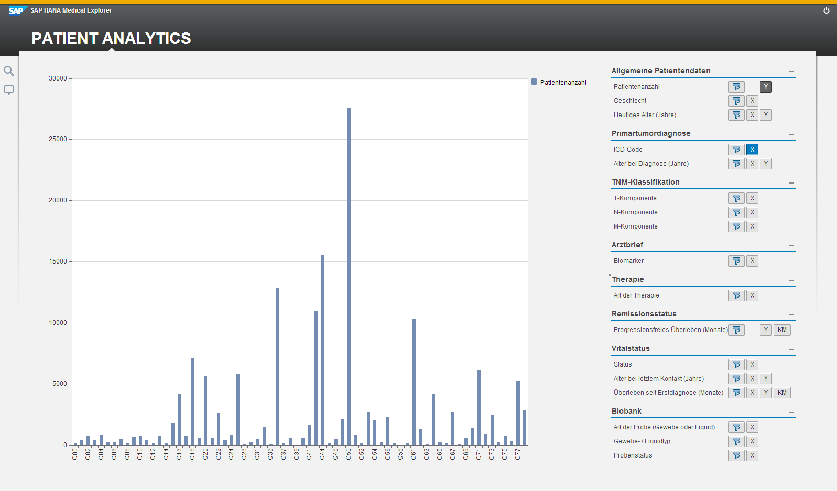
Cancer Data Exploration Provider: Visual Exploration by Domain Experts

Slide 24

Leading payer Making population health practice actionable
Accelerating care gap delivery
Alerting to sentinel events
Risk stratified drillable view for practices
Care management investment maximized by next best actions
Better leveraging payer population capabilities to drive better health

Slide 25

Leading provider Value-based care by personalizing population health
Extending successful program by greatly expanding data
Visual exploration of big data by domain experts
Honing value-based care pathways
Provider care pathway enablement
Harnessing patients as agents of their own wellness
Delivering higher quality care at lower price point in reproducible manner

Slide 26
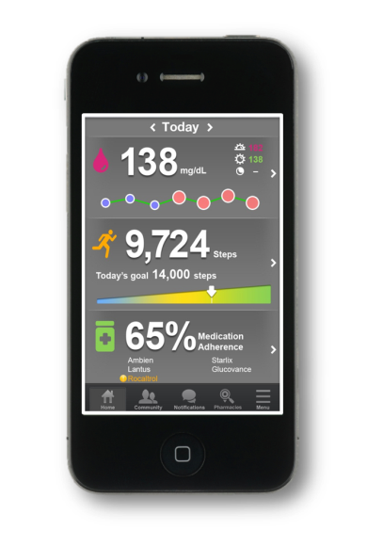
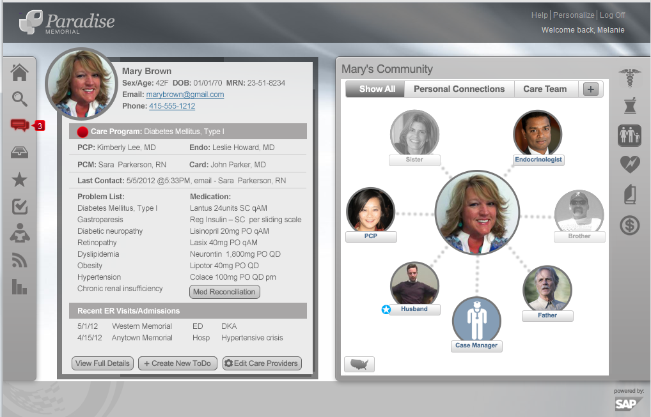
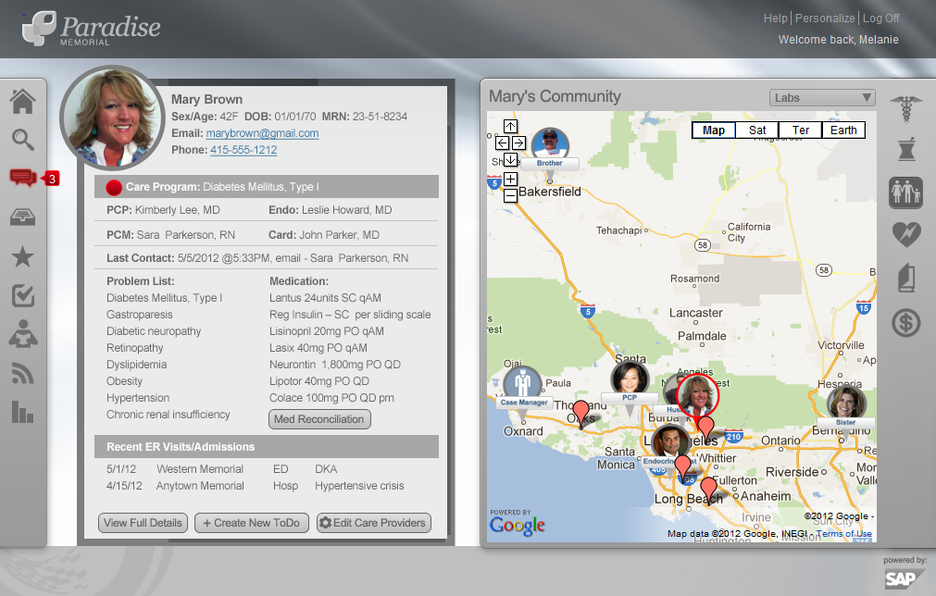

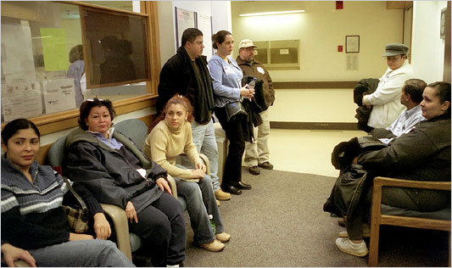
Relationships driving improved care and behavioral change

Slide 27
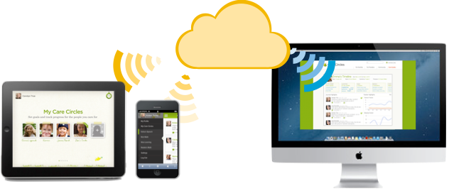
Care Circles
Care Circles
Find resources and coordinate Interventions to deliver better care for loved ones
Care Circles PRO
Monitor patients and identify strategies to improve outcomes and reduce readmissions
www.carecircles.com
Notes:
Care Circles is a free service that helps patients and their families to find best practices in caregiving from experts and caregivers around the world.

Slide 28


Medtronic, Inc. Life Sciences Industry – Global complaint handling benefitting 6M patients/year
60x faster processing queries from 3 hours to 3 minutes
10x data compression from 1.5 TB to 150 GB
250x better long text handling from 60 to 15,000 characters
Notes:
Product: Agile Datamart, Ops Rpt RDS v2
Business Challenges
Global complaint handling: Poor decision making and excess maintenance costs due to slow reporting
Global sales reporting: Unable to drive business growth due to weak communication between sales workers and physicians
Technical Challenges
Aggressive performance requirement
Multi-source data acquisition and management
Long-text handling
Faster access to big data
Benefits
Real-time analytics on customer feedback → improved satisfaction
Drive future product innovation
Speedier data-crunching → keep up with FDA record-handling rules
Competitive advantage over rivals such as Jude Medical and Boston Scientific
Competition
Won against Oracle Exadata, IBM Netezza
Experience SAP HANA benefitting 6M patients every year
A query that once took three or four hours now could be accomplished in three or four minutes → 60x faster processing speed
---------------------
The company’s top objectives
Overcome challenges with existing platforms (BW with Oracle DW), such as poor performing analytics, multi-source data acquisition and management, long-text handling
Manage, query and analyze long-text fields within Global Complaint Handling system
(mission-critical FDA mandated system which documents all customer feedback regarding implanted devices) with SAP HANA.
Global Sales Reporting project: Standardize the information provided to the Medtronic sales force globally in order to support and enhance their ability to sell Medtronic products
The key (anticipated) benefits
Optimized in-memory performance for Global Complaint Handling to analyze customer feedback, improve customer satisfaction, and drive future product innovation. HANA transforms incoming data from being “unmanageable” to a key corporate asset. This use case is aligned perfectly with the broader Medtronic mission “to improve another life every 4 seconds.”
Improved visibility to sales history, customer information, etc, will facilitate better, more meaningful discussions with customers, drive greater revenues and have more profitability sales engagements.
Highlights / WOW factor
Data size: Approximately 1.5 TB raw data compressed 10X to 150 GB in HANA.
Cursory consideration was given to Oracle Exadata and IBM Netezza, but HANA set itself distinctly apart with SAP’s articulation of our roadmap that positions it as the application platform for SAP going forward.
Medtronic has taken every opportunity to share their HANA story at external events, such as SAP World Tour, TechEd, SAPPHIRE, Insider Profiles, ReferencesLIVE calls.
------------------------
Medtronic – business problems / benefits
Needed to overcome reporting challenges
inconsistent data definitions
global reporting not defined
gaps in communication, training, documentation
myriad of tools and technologies, not integrated
redundant data elements
limited resources to do the reporting
Needed to expand how the company handles chronic disease
fast access required
huge data sets now the norm
-----------------------------------------------------------------------------------------------------------
Press release:
Hedges studied his IT systems and found several areas in which IT could be used as a tool for growth:
by finding ways to more quickly sort through the thousands of hospital and patient reports about medical devices, such as diabetic pumps and pacemakers.
The company also could boost sales by doing a better job compiling global sales reports, he said.
The idea was that employing faster information systems would provide Medtronic a competitive advantage over rivals such as Jude Medical and Boston Scientific. Speedier data-crunching would also help the company keep up with FDA record-handling rules, Hedges believed. “You don’t want to tell the FDA to come back in two weeks,” when it comes for an audit, Hedges said. Such improvements, he reasoned, would help improve products and identify the greatest sources of demand, all key to growing the bottom line.
To meet those goals, Hedges turned to new software to manage the volume of company data, which was exploding. In 2011, Medtronic’s data warehouse system processed one patient feedback record about a device every second. But as the volume of information from patients who use Medtronic devices grew, the company failed to process the records effectively. The existing data warehouse software couldn’t read large text fields that encapsulated customer complaints.
Medtronic used new database software to accelerate its processing speed. A query that once took three or four hours now could be accomplished in three or four minutes. The new HANA database software from SAP derives its speed from “in-memory” technology that combines a processor and memory on a single chip, eliminating the delays inherent in systems with separate processors and hard drives.
Medtronic also is in the early stages of testing a sales reporting application to strengthen communications between sales workers and physicians who assign medical devices to patients, Hedges said. This application collects information about how products are selling, which hospitals are buying what equipment, and where medical devices are being implanted and when. The idea is to enable sales workers to spend more time with customers and patients, Hedges said.
Hedges said his team looked at other solutions—but picked HANA, in large part because it was familiar with SAP. Hedges said he figured turning to HANA would make it easier for his team to get the software running and tuned to the company’s business operations.
Hedges said his team struggled to move the data from the SAP data warehouse to the new HANA database, owing to the fact that the old data warehouse software ran much more slowly than HANA. By the end of the year, Hedges says, 5,000 to 7,000 of the company’s 40,000 employees who are spread across 270 locations around the world, will be using the HANA system. He expects that number to increase to 15,000 in 2013. And Hedges said he intends to have as many as 3,000 sales representatives using the HANA-powered global sales reports in the next few months.
It will still be some time before the company realizes any business gain from the investment, though. Medtronic has suffered from weak demand for its implantable heart defibrillators and spine products amid a soft global economy. Sales in each of those units fell 9% in the third quarter, which ended in February.

Slide 29
Agenda
Our POV on Healthcare and Big Data
SAP HANA Innovations
SAP HANA Transformational Impact at Customers
Summary

Slide 30
SAP HANA Platform: Rethink the possible Uncover more business value while enabling breakthrough transformation
SAP HANA platform converges database and application platform capabilities in-memory to power real-time enterprise and enable entirely new classes of applications.

Slide 31

Thank you
Come visit us at booth 104
Notes:
[ ] Acid compliant

Slide 32


Real Time Enterprise: Managing the Present & Predicting the Future

